Slide 1

Tableau prep – gender pay gap
By Sajith Vellappillil
Submitted to prof Hamid rajaee

Slide 2
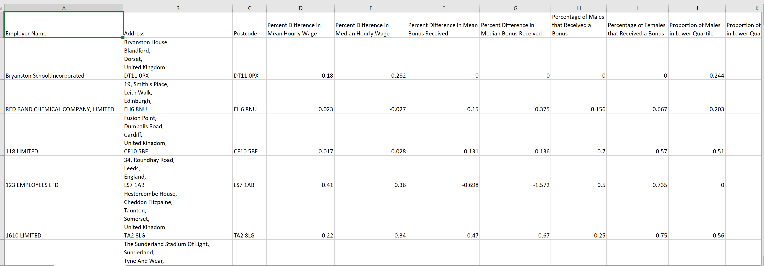
Dataset – 2018 Gender Pay Gap
Gender Pay Gap - The gender wage gap is the difference between wages earned by men and wages earned by women.
About this Dataset
SOURCE: GOV.UK

Slide 3
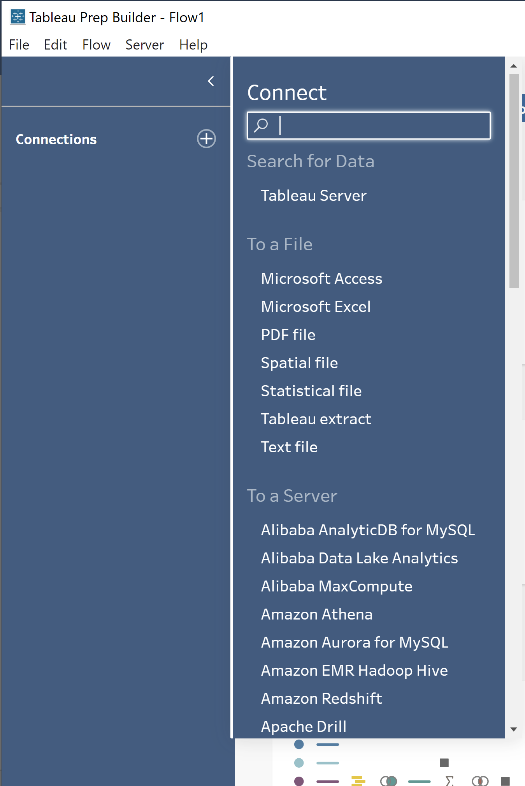
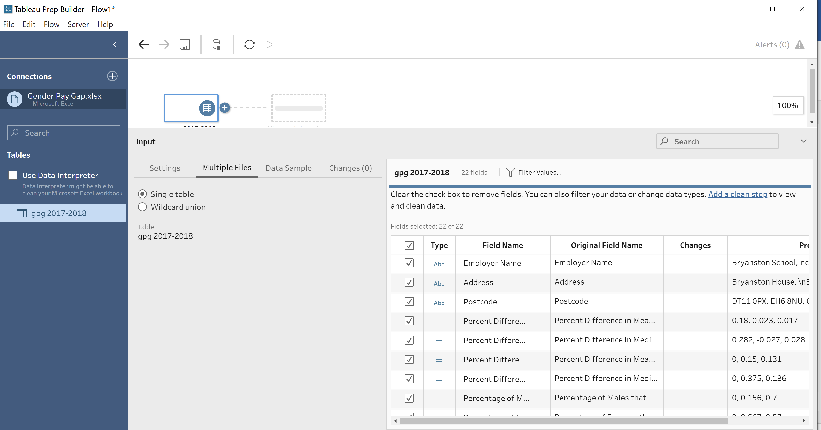
Loading dataset

Slide 4
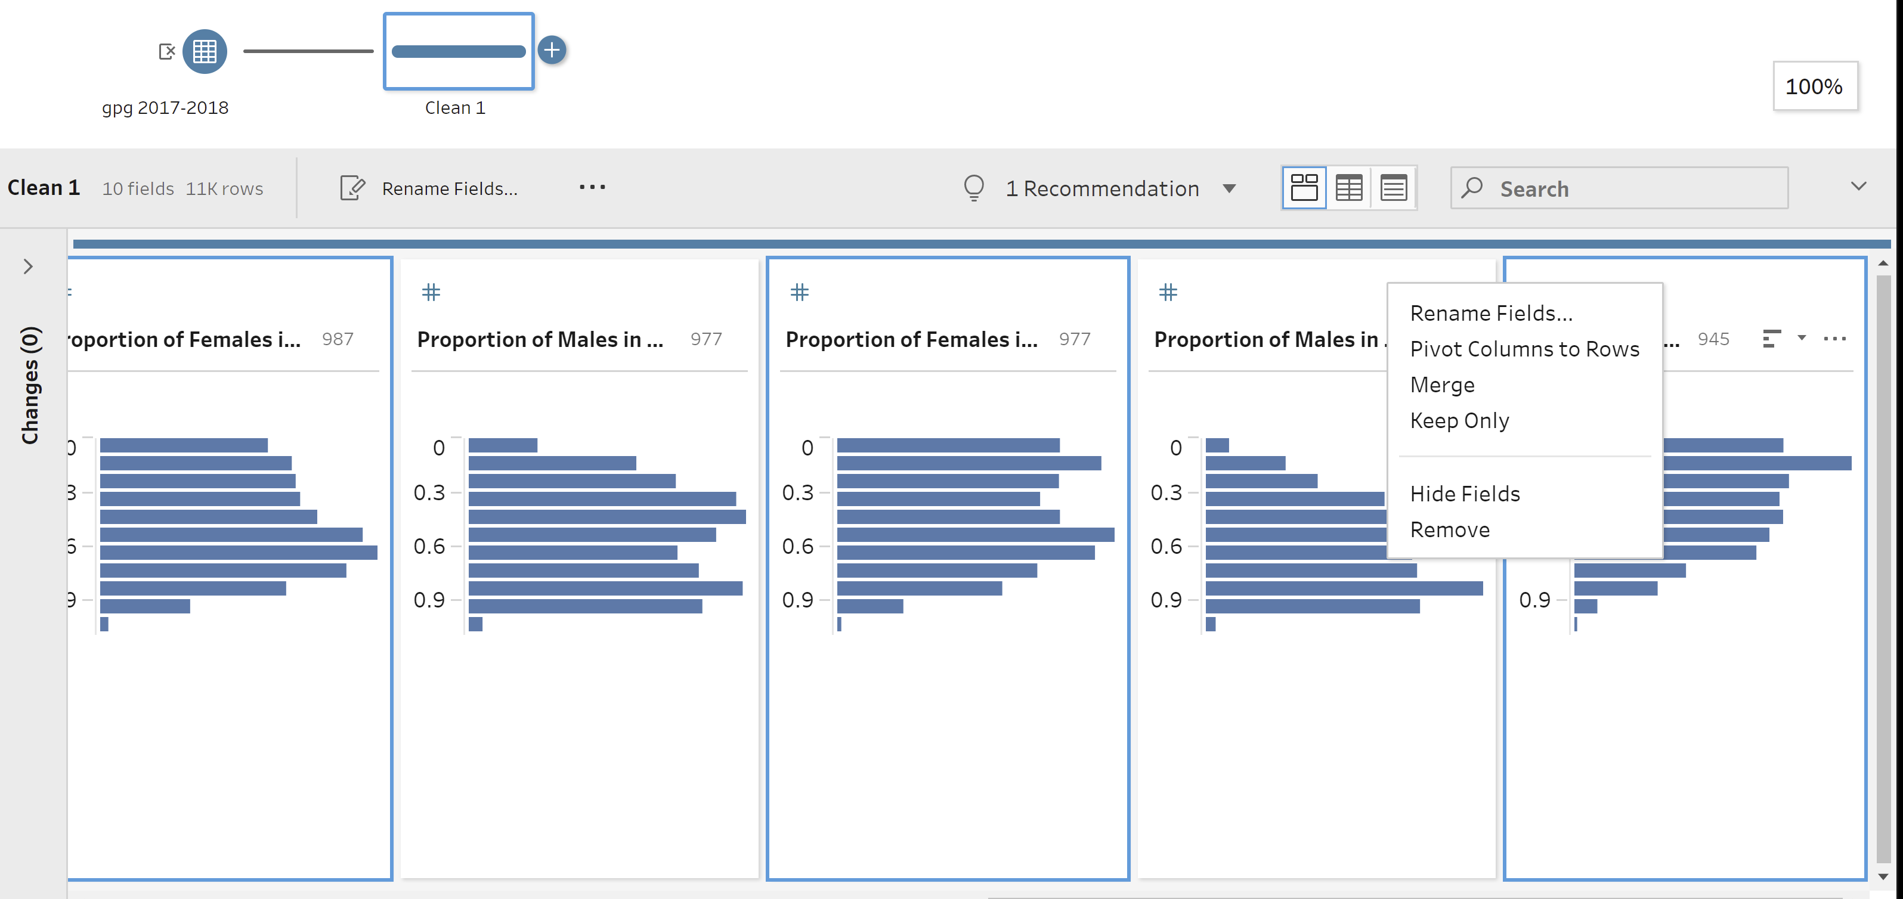
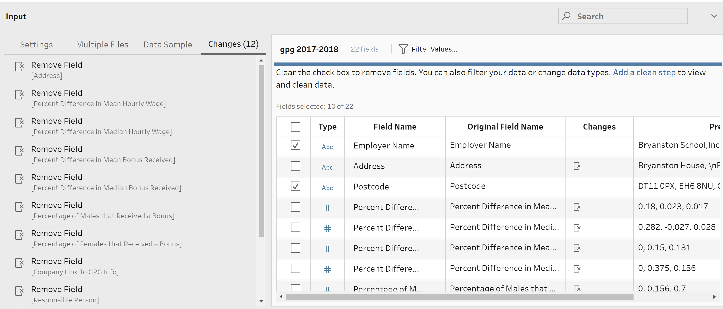
Remove unwanted columns

Slide 5
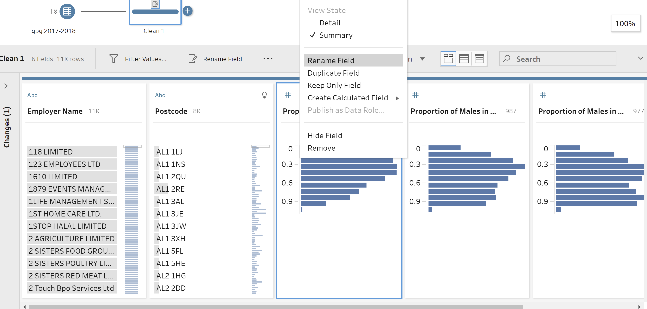
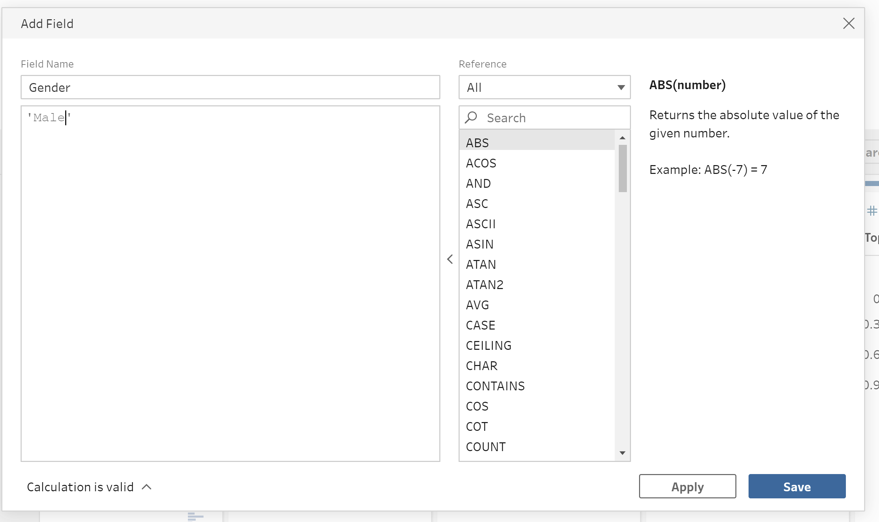
Rename column create new column

Slide 6
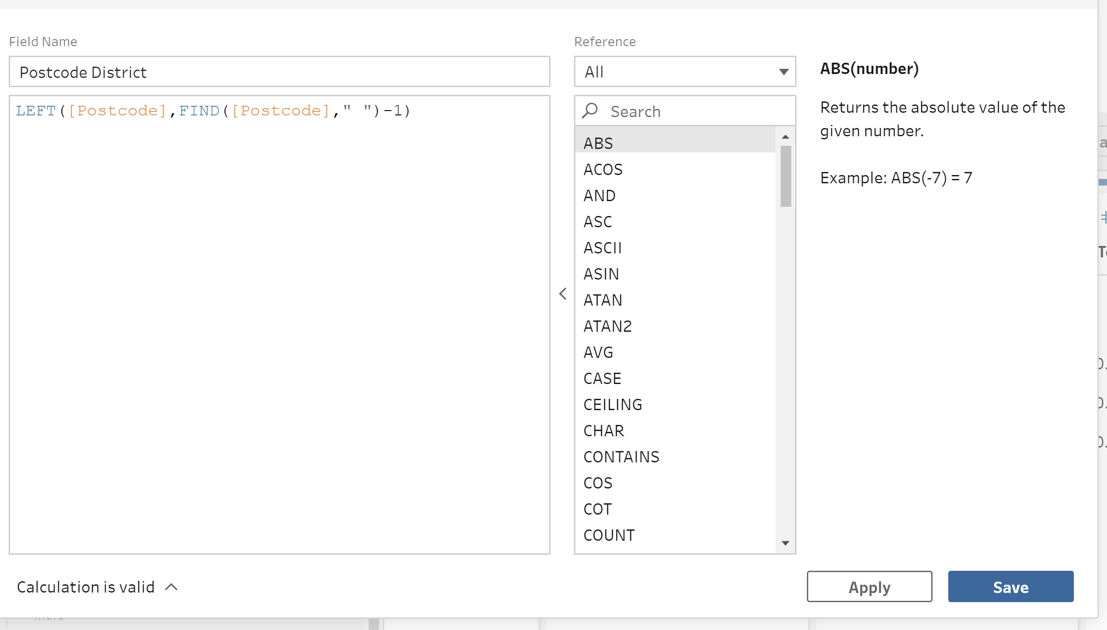
Created New column POSTCODE district from column postcode

Slide 7
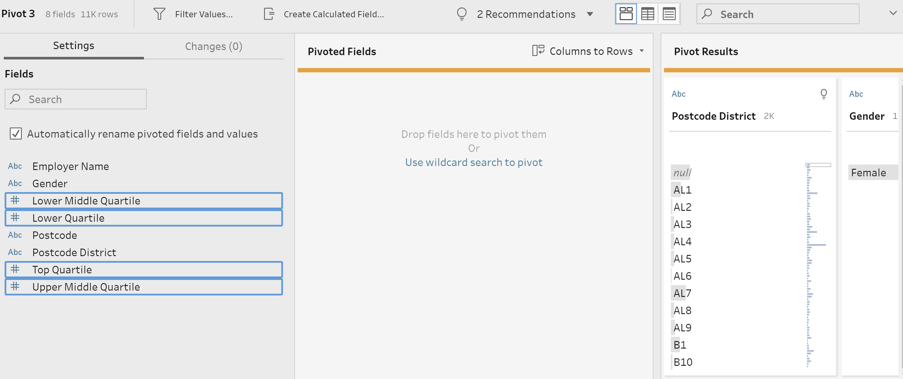
Selected fields for pivot table

Slide 8
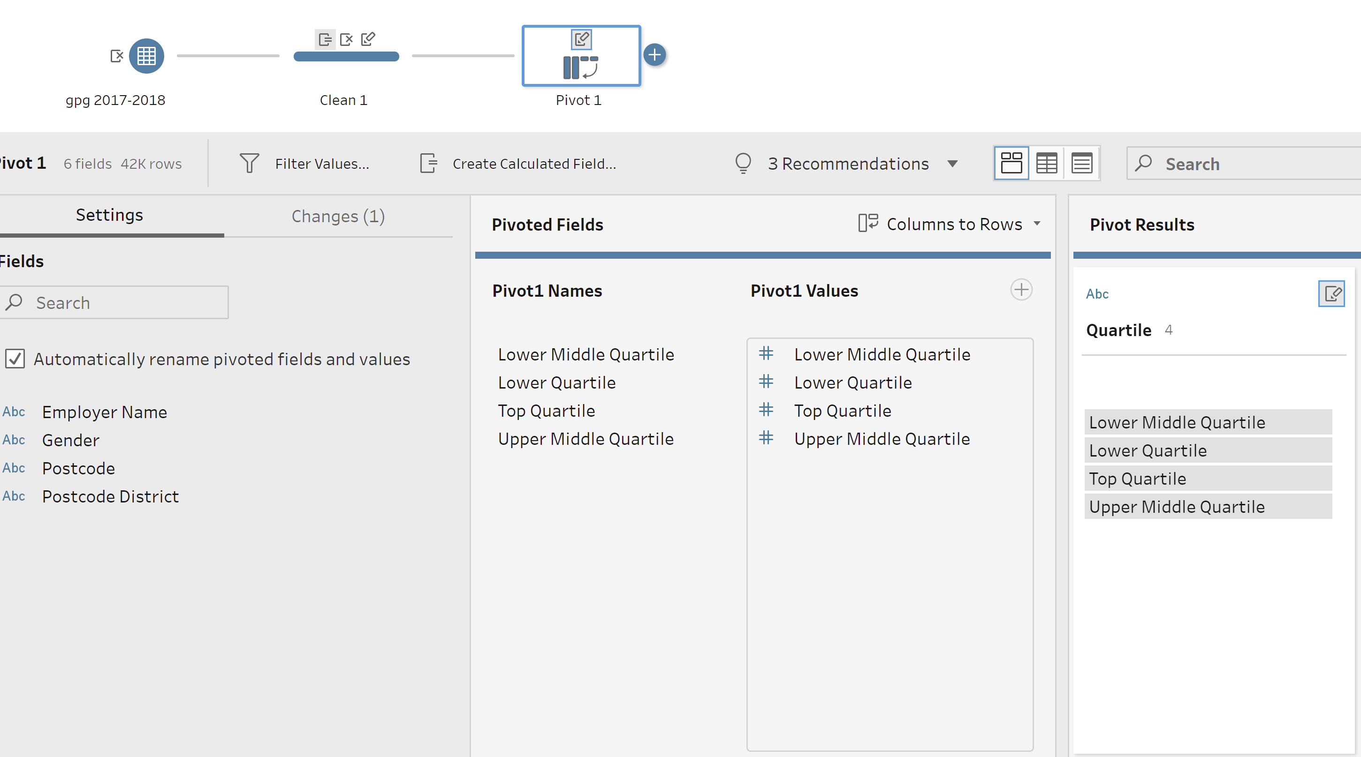
Add pivot table and rename

Slide 9
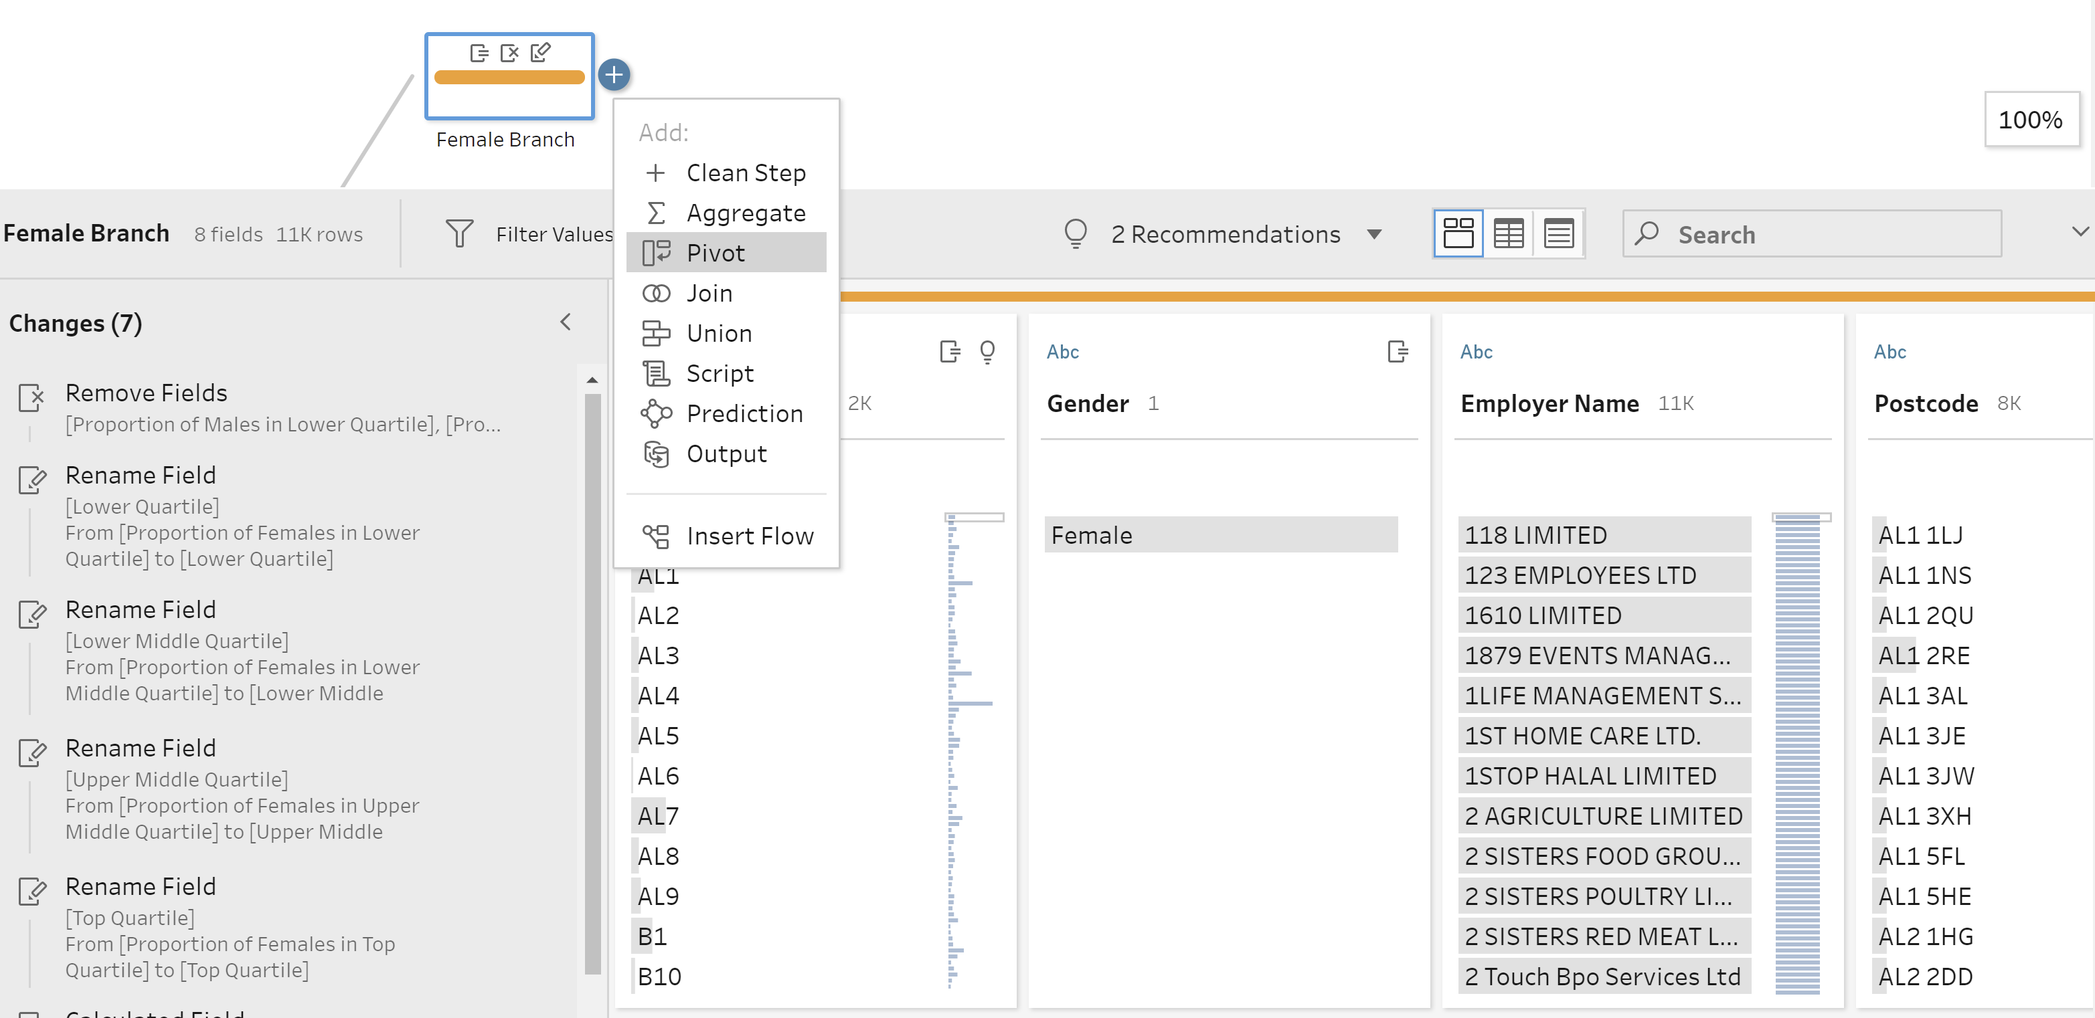
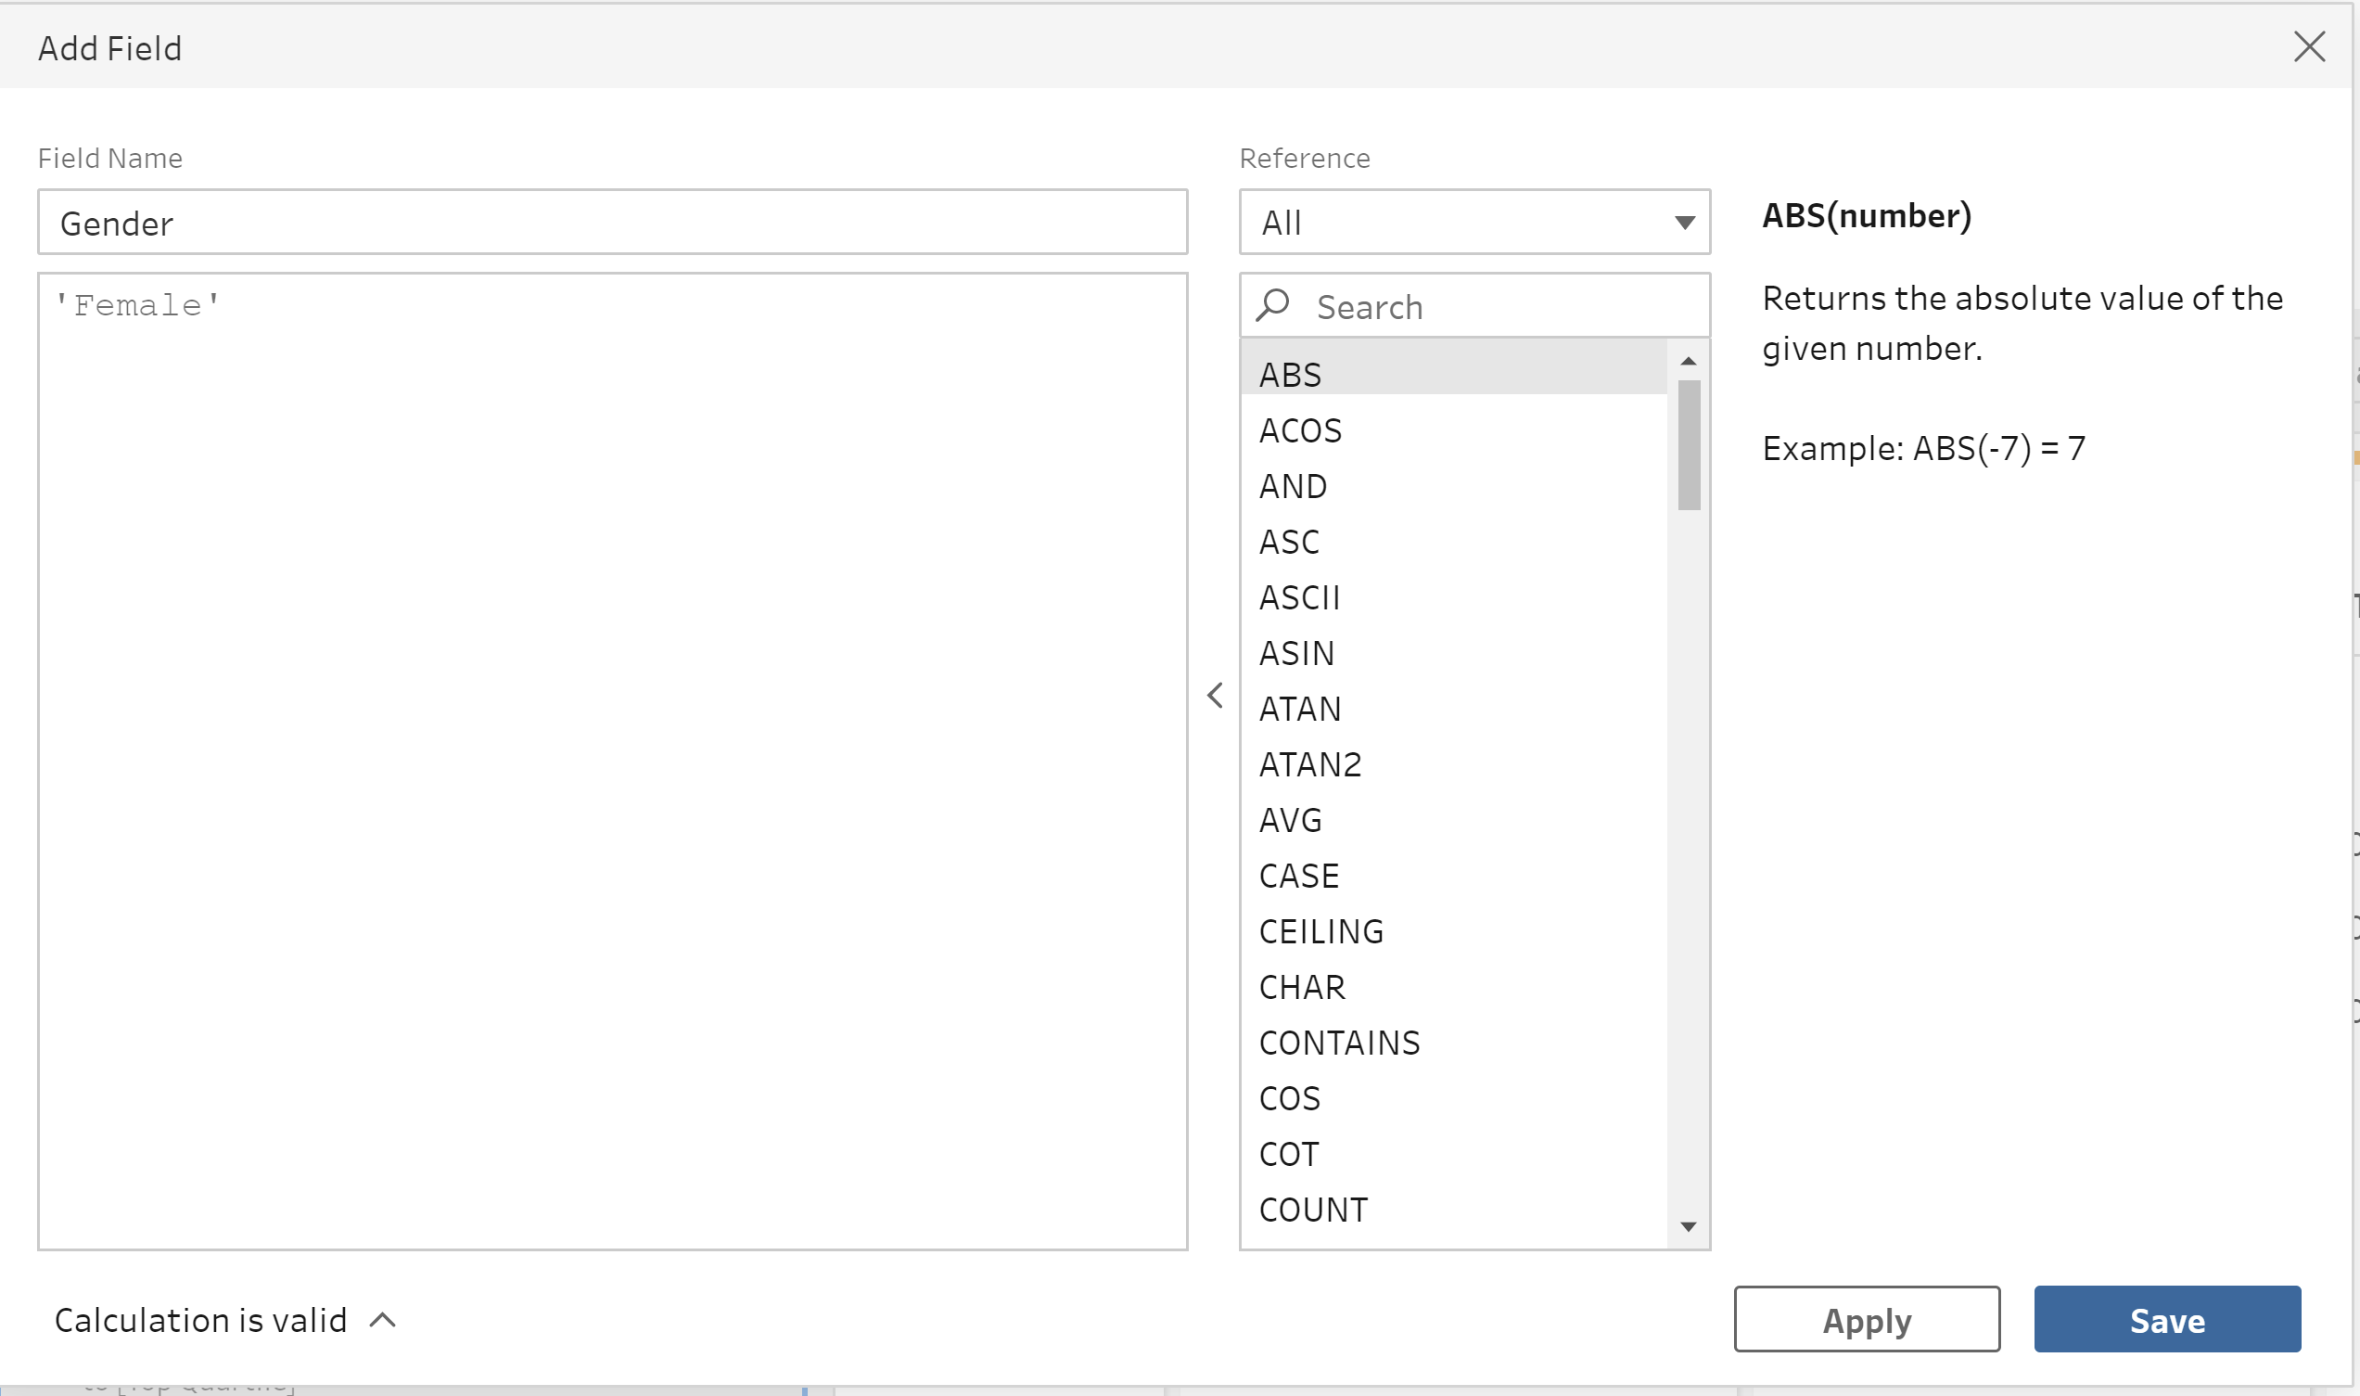
Add column female and create pivot

Slide 10
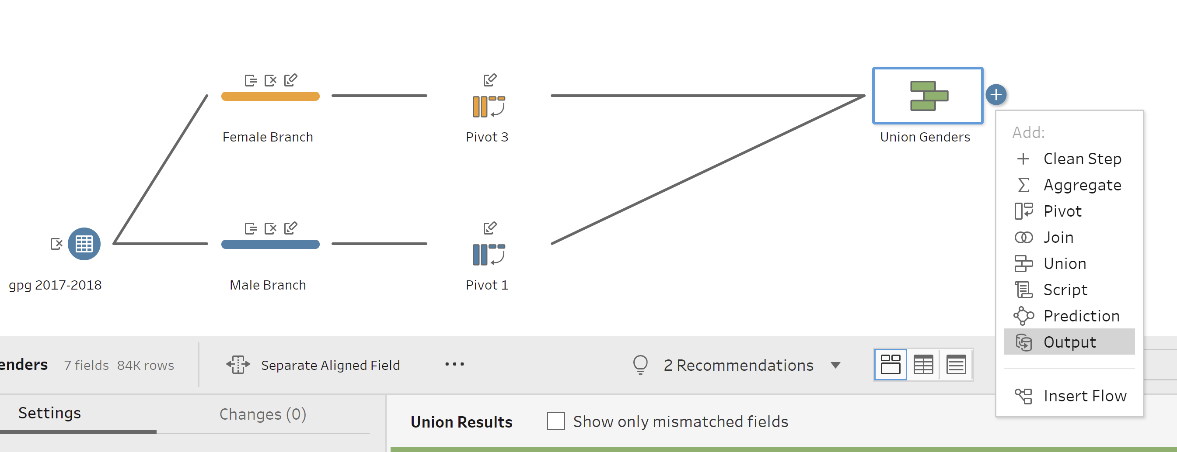
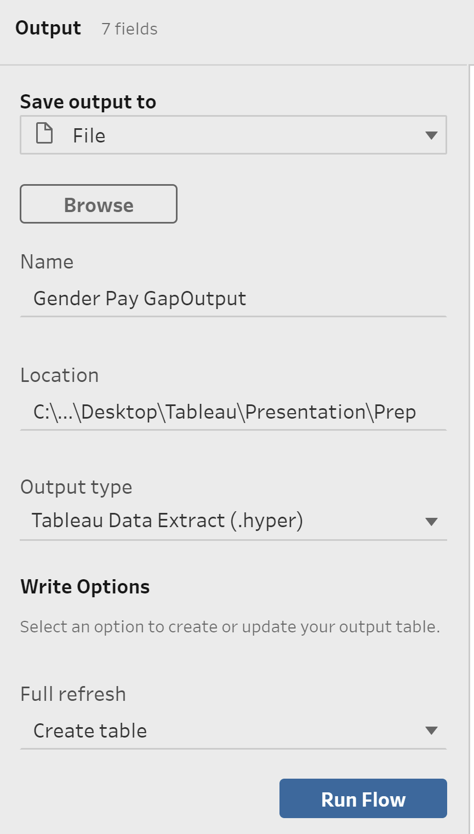
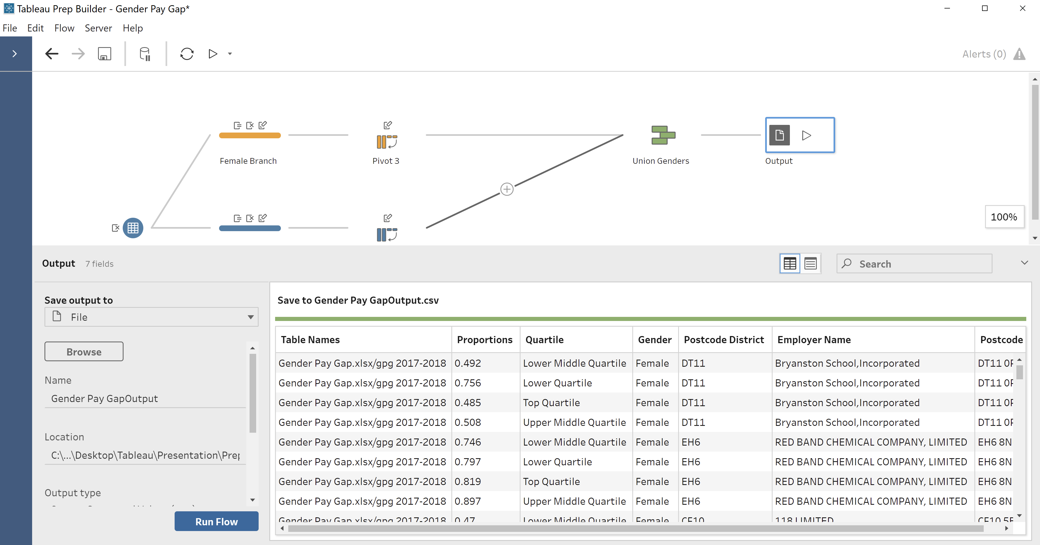
output

Slide 11
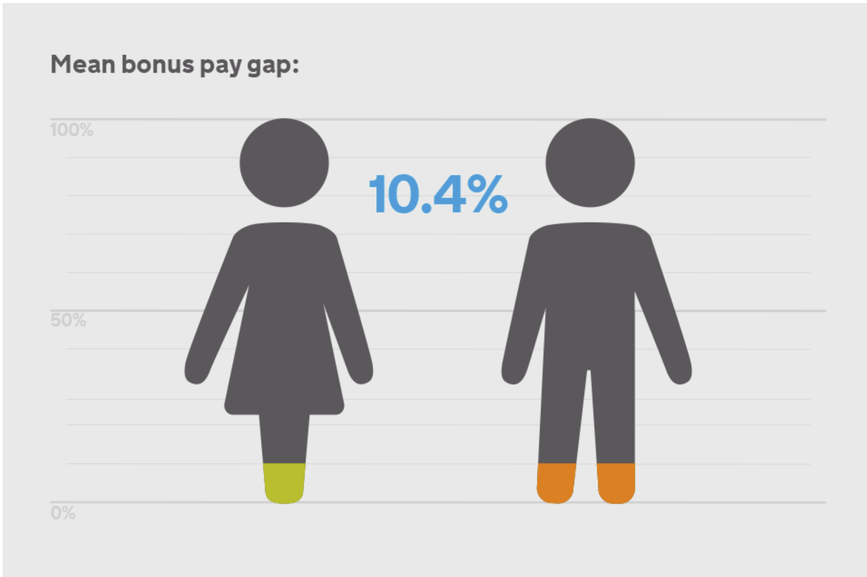
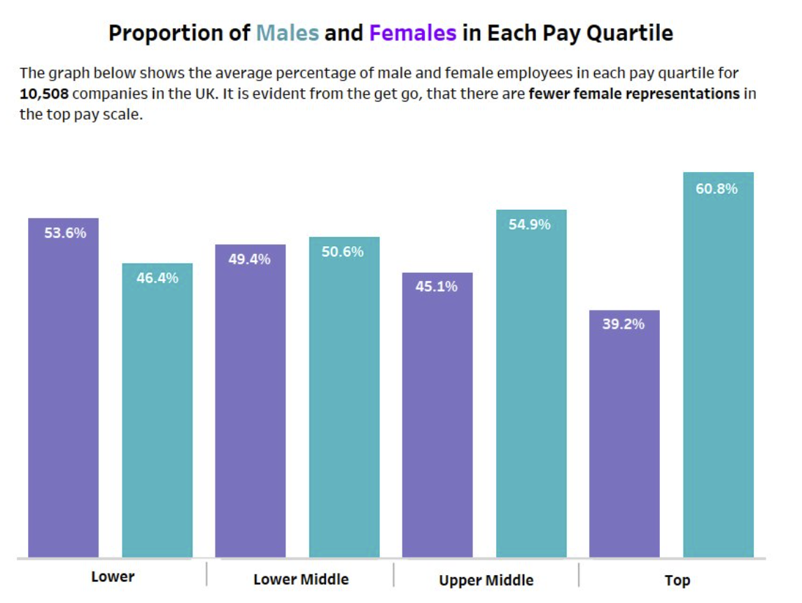
Dataset inferences – source: makeover monday

Slide 12

Tableau desktop – videogame sales By Sajith Vellappillil Submitted to prof Hamid rajaee

Slide 13
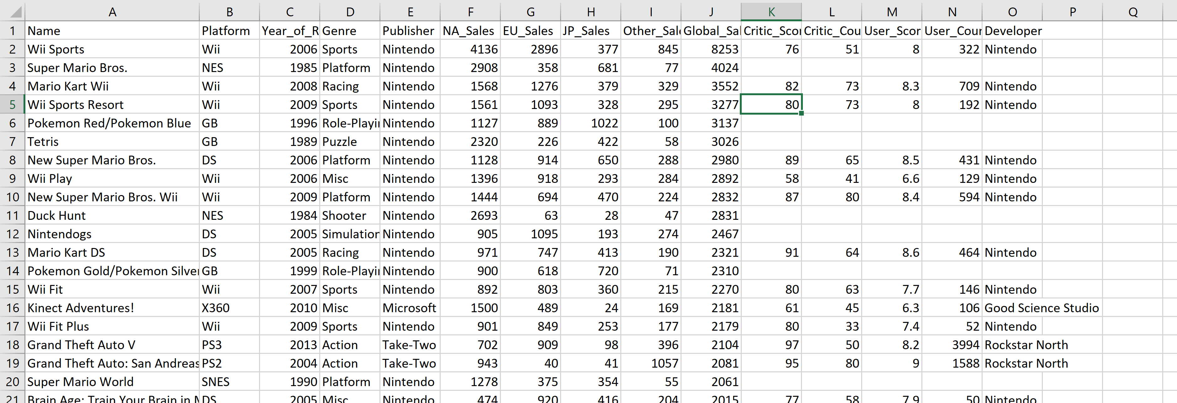
Dataset – videogame sales
SOURCE: KAGGLE

Slide 14
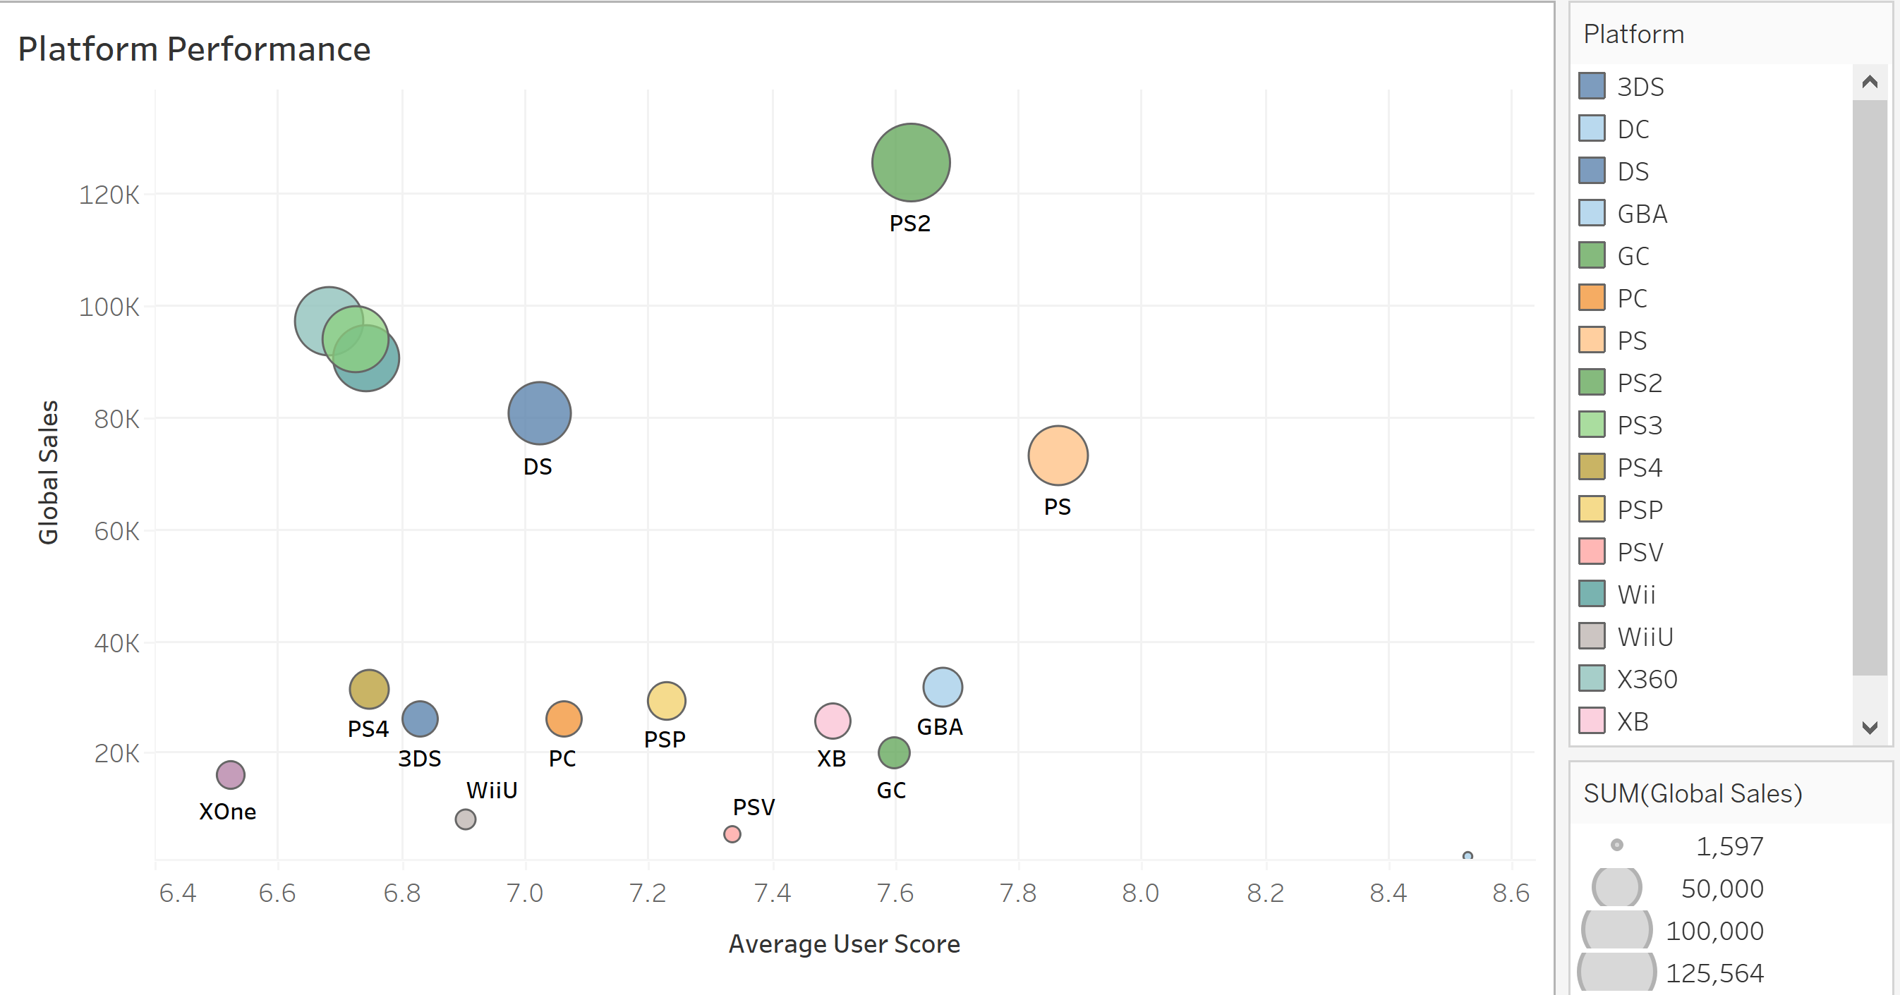
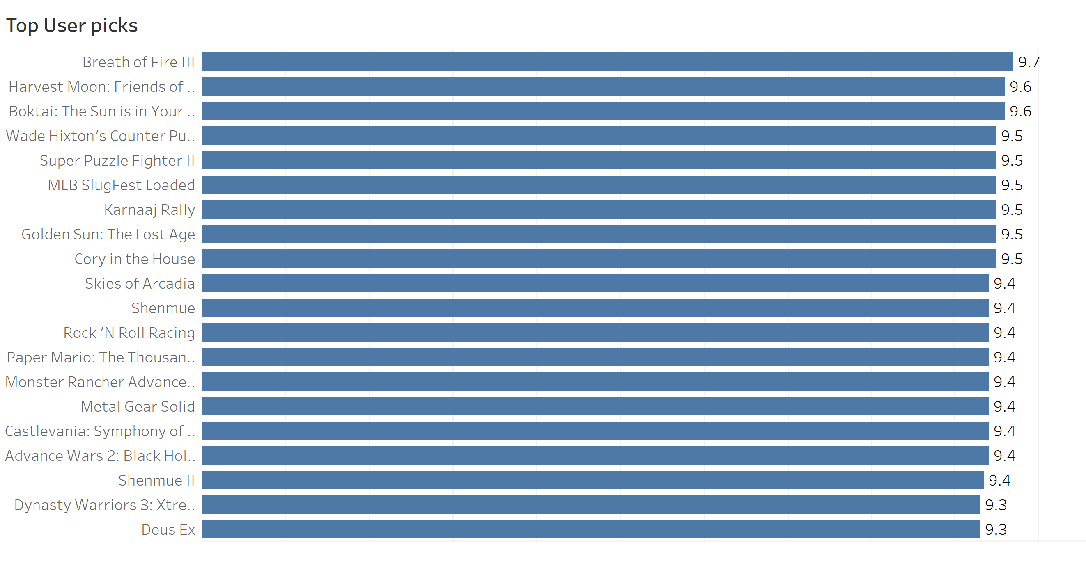
Worksheets on tableau desktop – video game sales

Slide 15
TOP VIDEOGAME REGIONWISE
Wii Sports with 4.1K sales
JAPAN
Pokemon Red/Pokemon Blue with 1k Sales
EUROPE
Wii Sports with 2.9K Sales
NORTH AMERICA

Slide 16
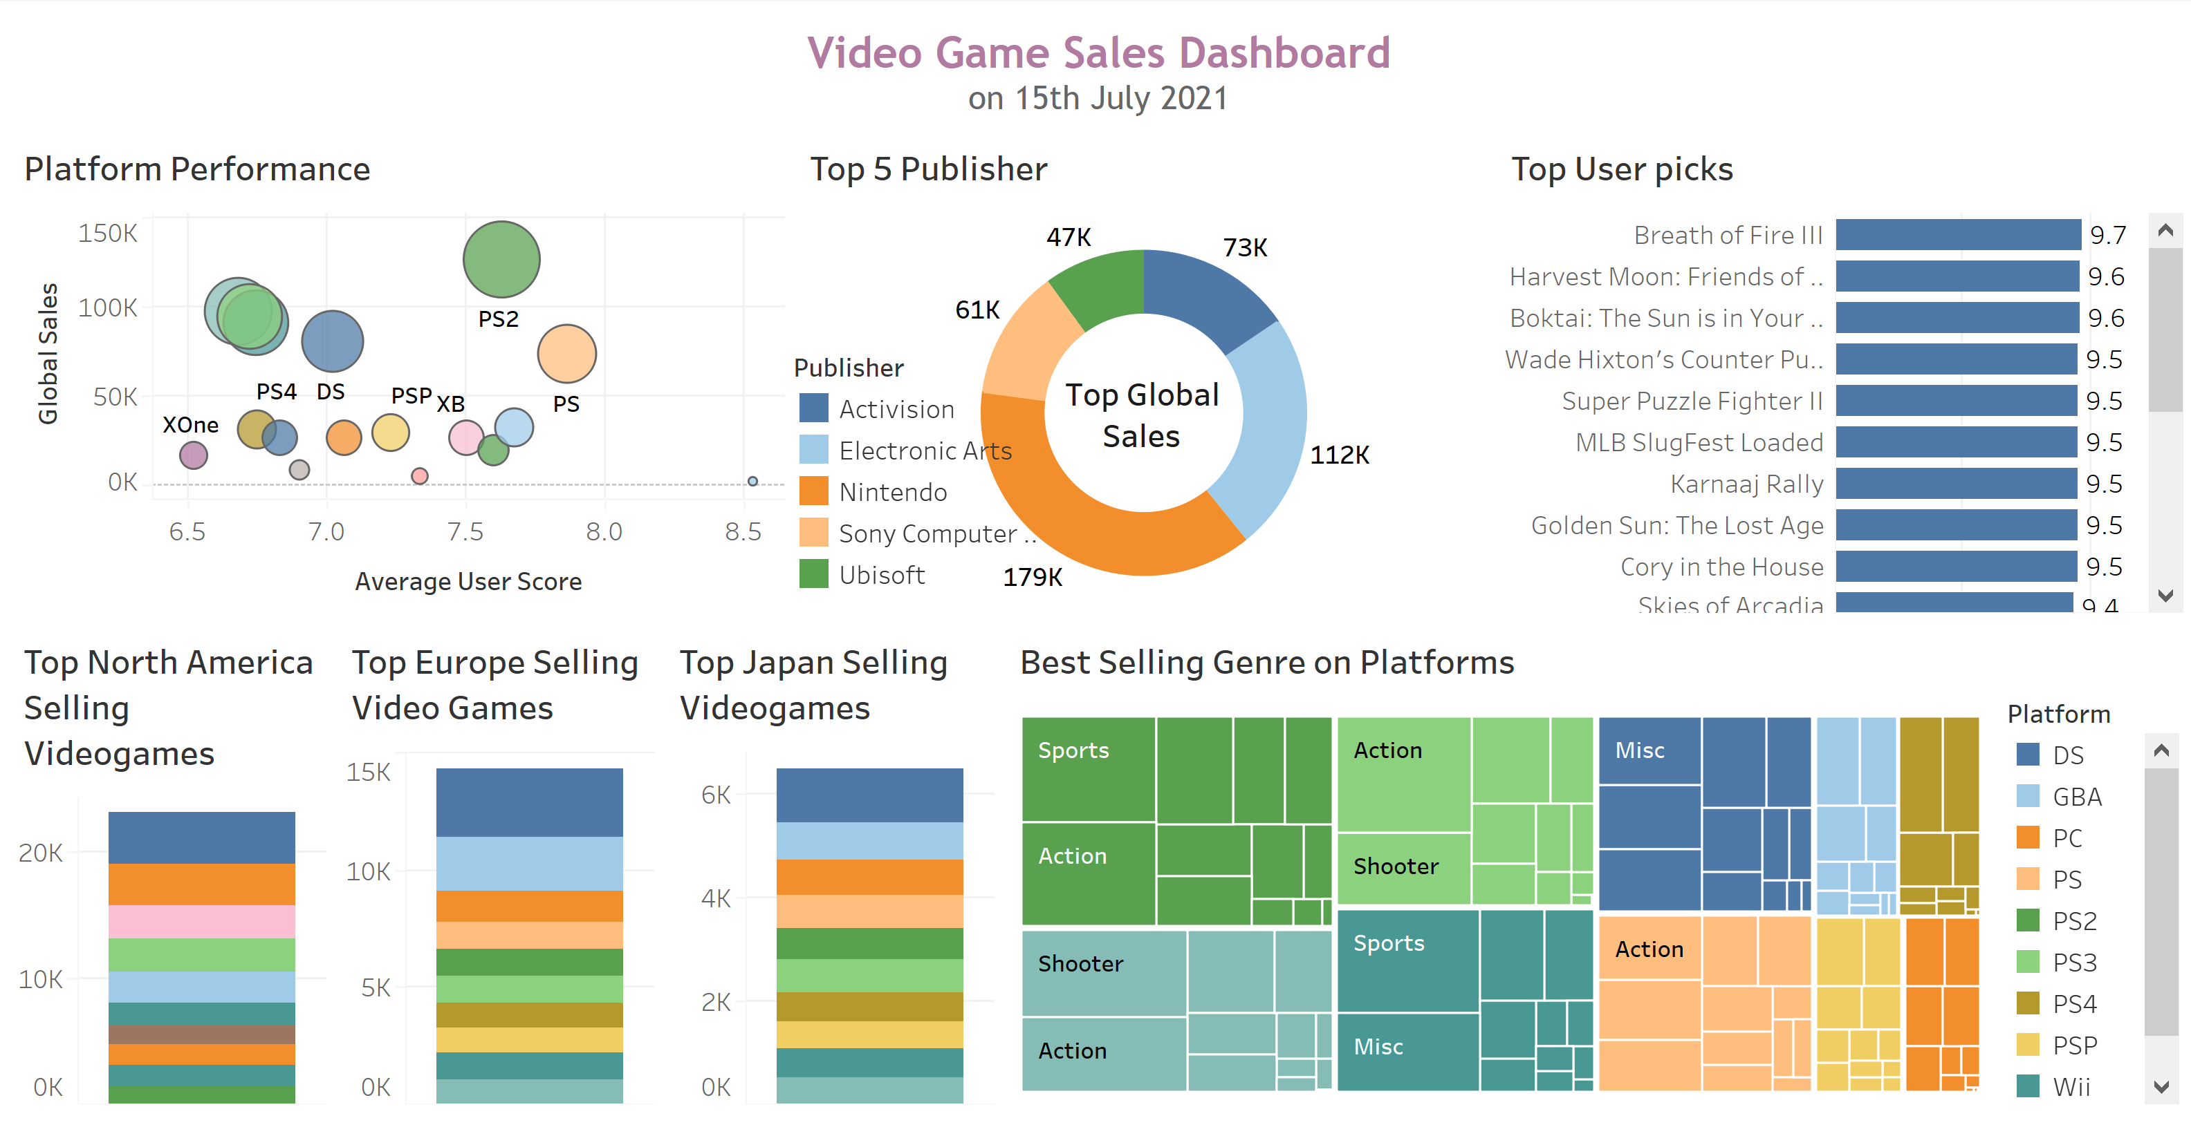
Dashboard – video game sales

Slide 17
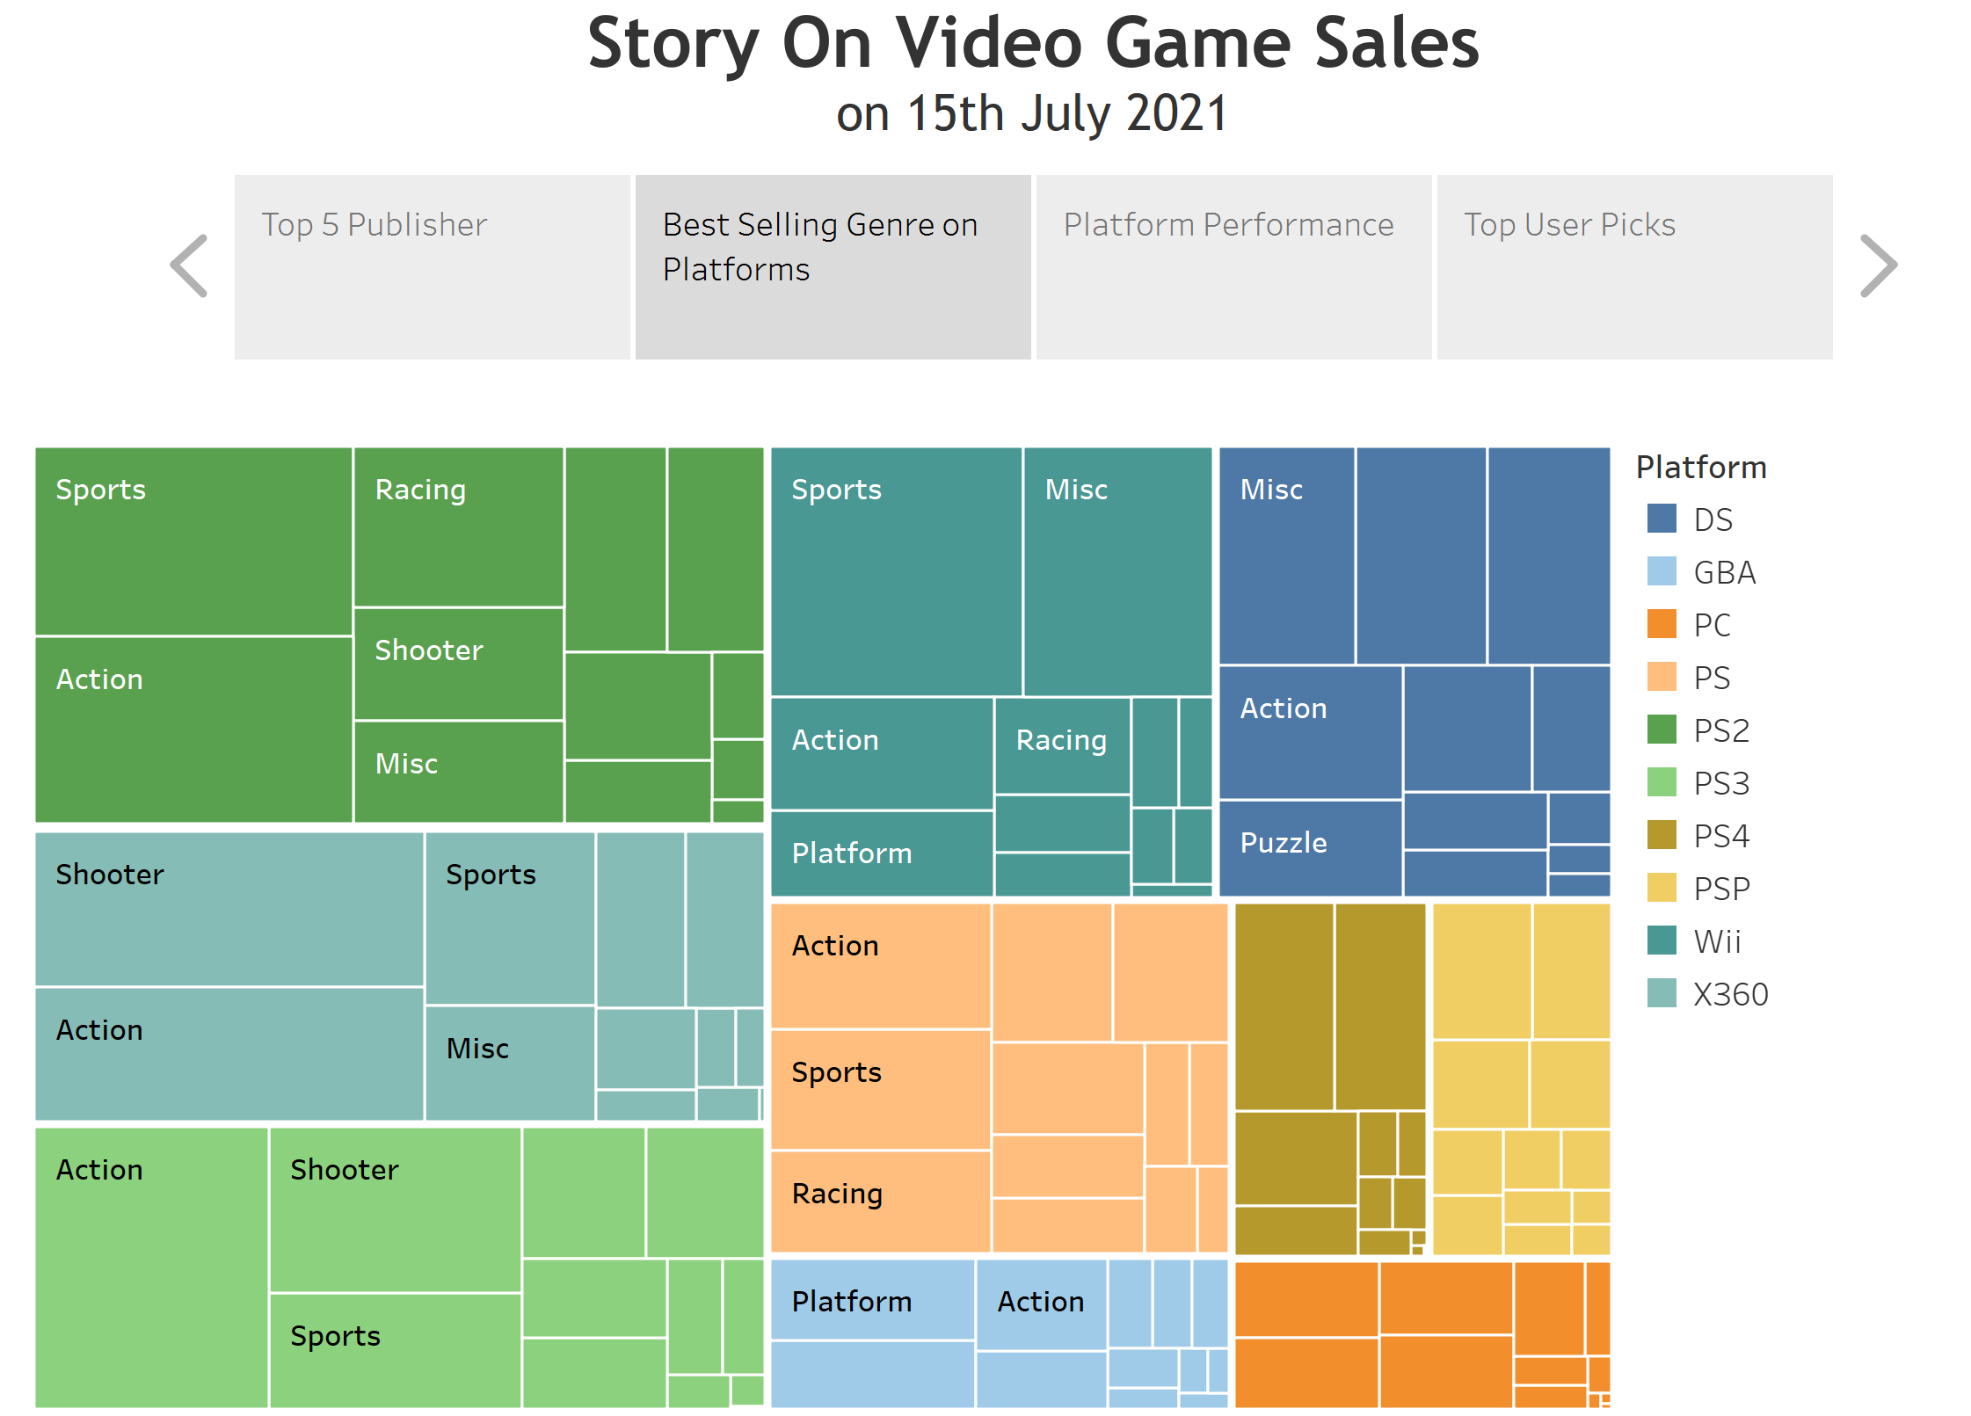
Story – video game sales

Slide 18
conclusion
Top selling Videogame:
North America : Wii Sports
Japan: Pokemon
Europe: Wii Sports
Top User Pick: Breath of Fire III
Best Platform: PS , however top sales are on PS2
Worst Platform: Xone and has the lowest sales
Best Selling Genre on Best platform PS2: Sports and action
Highest Selling Genre: Action
Top Publisher: Activision has global Sales of 73K

Slide 19



Slide 20
Thank You

